Slide 1
Caught Between Cultures : How Young Migrant Adults in Mumbai Navigate Traditional Family Expectations and Modern Lifestyles
Priyanshu Sharma
Hari Krishnan P
Harsha Shyjilin
Sreya Bhattacharya

Slide 2
OVERVIEW
We aim to understand how young migrant adults manage family expectations while pursuing independence and modern lifestyles.
We explored the personal conflicts and emotional experiences of young adults who feel torn between traditional values and their desire for modern, independent lifestyles.
This topic is highly relevant to the changing social dynamics in India. And Mumbai being a metropolitan city blends modern influences with deep rooted traditional values.
The insights gathered can help in understanding personal and emotional experiences of the young adults.

Slide 3
OBJECTIVEs
Explore Cultural Identity: Investigate how young migrant adults perceive and navigate their cultural identities amidst traditional family expectations and modern lifestyles.
Examine Family Influences: Analyze the impact of familial expectations on personal choices related to education, career, and relationships.
Assess Social Contexts: Evaluate the role of peer influences and community support in shaping their experiences and choices.
Highlight Individual Narratives: Capture diverse personal stories to understand how factors like gender and socioeconomic status affect their navigation between cultures.

Slide 4
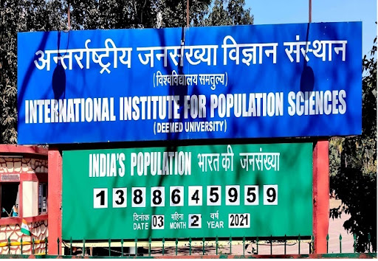
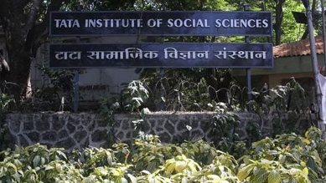
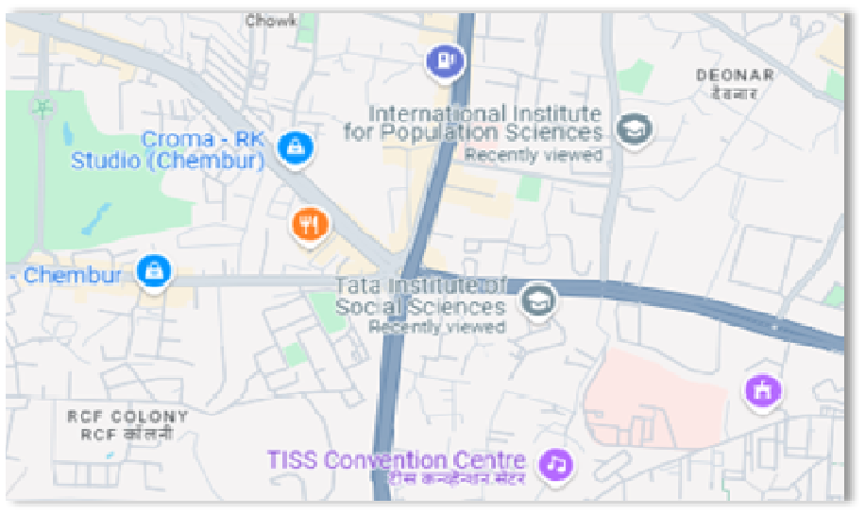
STUDY AREA
The study has been conducted in –
IIPS (International Institute for Population sciences)
TISS (Tata Institute for Social Sciences)

Slide 5
Target Population
Young adult migrants in Mumbai
Data Collection
Confidentiality
All responses will be confidential
In-depth interviews with open-ended questions
Sampling Technique
We used Convenience Sampling Method for the study.
METHODOLOGY

Slide 6
Reason for Choosing In-Depth Interviews
Flexibility
Personal Connection Building
Rich, Detailed Data

Slide 7
STEPS WE USED IN THE IN-DEPTH INTERVIEW
Define Objectives: Clarify the purpose and goals of the interviews.
Select Participants: Identify and recruit participants that fit the target population criteria.
Develop Interview Guide: Create a semi-structured guide with open-ended questions to facilitate discussion.
Build Rapport: Establish a comfortable and trusting environment with participants.
Conduct Interviews: Engage participants in conversation, encouraging them to share their experiences.
Record Data: Take audio record interviews for accurate data collection and made detailed transcripts.
Analyze Responses: We analyzed data in Atlus.ti and interpret to identify themes and insights.

Slide 8
Field Experiences
We get to know diverse perspectives on balancing modern lifestyle with family traditions and expectations.
Participants shared their personal stories and revealed deep emotional connection to their cultural identities and family pressures.
Experienced significance of establishing Rapport with the participants.
Gained insights into specific cultural nuances that influenced the experience of the young migrants.

Slide 9
DIFFICULTIES WE FACED
Time Constraints: Coordinating interview schedules was sometimes difficult, as participants balanced academic and work commitments.
Location Constraints: Finding quiet, comfortable spaces for interviews was occasionally challenging in busy environments
Sensitive Topics: Discussing cultural pressures and personal struggles sometimes led to emotional responses, requiring careful navigation.
Emotional Responses: Participants sometimes shared deeply personal or painful experiences, which made it challenging to maintain a neutral stance during interviews.

Slide 10
INFERENCEs Drawn from the Study
Family Dynamics: Family expectations play a significant role in shaping personal choices, with many participants feeling pressure to conform to traditional paths while striving for individual aspirations
Influence of Peer Networks: Social circles and peer influences are crucial in shaping attitudes and choices
Adaptation: Participants demonstrate resilience and adaptability, developing effective coping strategies to navigate cultural tensions and personal identity conflicts.
Stress : The struggle to meet both familial and personal expectations can lead to stress and identity confusion for some
Gender Role Differences: There were notable differences in perspectives between male and female respondents, with female participants more likely to emphasize the importance of equality in modern lifestyles.

Slide 11
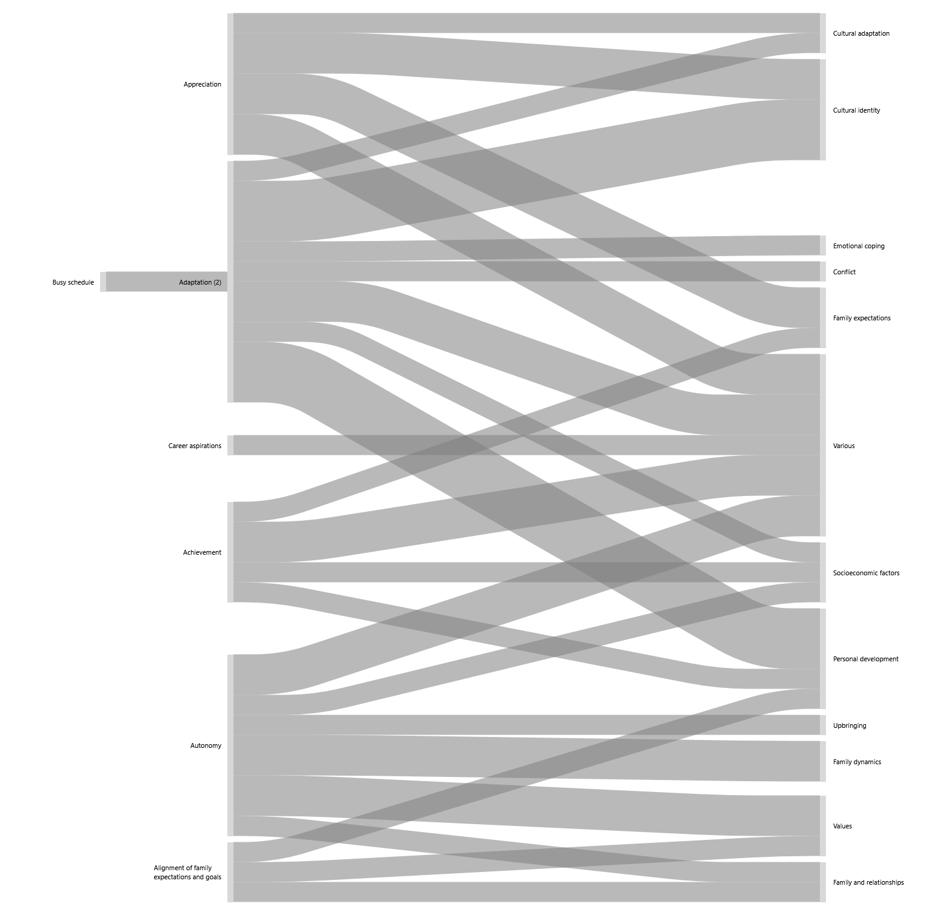
ANALYSIS
SANKY DIAGRAM :
The Sankey diagram visually represents how young migrant adults in Mumbai navigate the balance between traditional family expectations and modern lifestyles.
Arrows illustrate the influence of traditional values (family, community expectations) versus modern influences (education, peer interactions)
Emphasize the complexity of their experiences, showing that many young adults experience a blend of both cultural influences, reflected in the overlapping flows.
This navigation impacts their identity, relationships, and future aspirations, as depicted in the varying widths of the arrows.

Slide 12
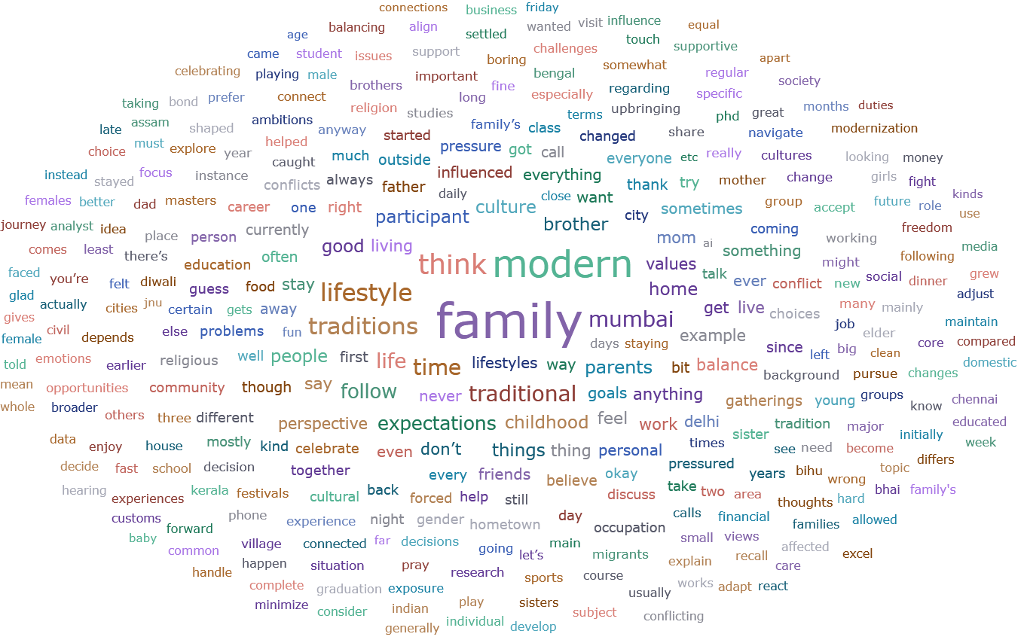
WORD CLOUD

Slide 13
CONCLUSION
Complex Experiences: Young migrant adults navigate the demands of traditional family expectations alongside modern societal influences.
Cultural Embrace: Many participants accept family traditions while advocating for personal autonomy and equality.
Gender Role Insights: Female respondents emphasized the importance of equality in modern lifestyles, highlighting differing perspectives between genders.
Resilience and Adaptation: Participants demonstrated resilience, effectively negotiating their identities within cultural tensions.
Importance of Dialogue: Open communication within families is crucial for fostering understanding and support.
Need for Support Systems: There is a clear necessity for community and institutional support tailored to the unique challenges faced by young migrant adults.
Contribution to Understanding: The research provides valuable insights into the interplay of culture, identity, and modernity, laying the groundwork for further exploration and support initiatives.

Slide 14


